Slide 1
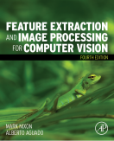
Lecture 4 Point Operators
COMP3204 Computer Vision
How many different operators are there which operate on image points?
 | Book pp 84-95

Slide 2
Content
How do we best display images?
What operators are available which work solely on image points?

Slide 3

An image and its histogram
The histogram shows contrast

Slide 4

Brightening an image
new image N; old image O; gain k; level l; co-ordinates x,y
Then choose values for k and l

Slide 5
Intensity mappings

Slide 6


Applying exponential and logarithmic point operators
Brightness compression
Brightness expansion

Slide 7
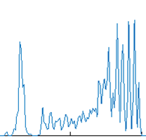
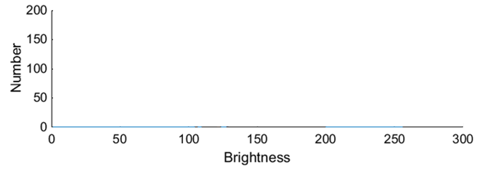
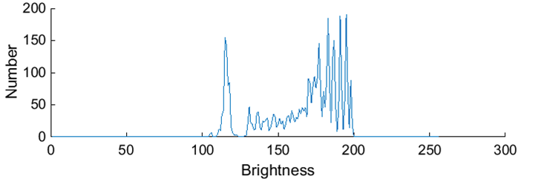
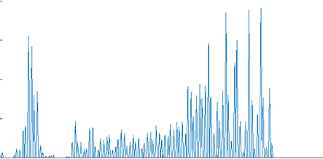
Intensity normalisation - function
Aim is to use all available grey levels for display
Original histogram
Shift origin to zero
Scale brightness to use whole range

Slide 8
Intensity normalisation
$$N_{x,y}= \left(O_{x,y}−Omin\right)$$

Slide 9
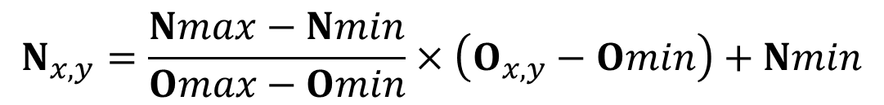
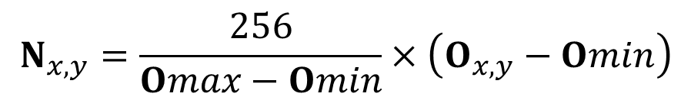
Intensity normalisation
$$N_{x,y}=\frac{Nmax−Nmin}{Omax−Omin}×\left(O_{x,y}−Omin\right)+Nmin$$
new image N; old image O; co-ordinates x,y
minimum new Nmin
maximum new Nmax
minimum original Omin
maximum original Omax
$$N_{x,y}=\frac{256}{Omax−Omin}×\left(O_{x,y}−Omin\right)$$
Avoids need for parameter choice

Slide 10
Intensity normalisation and histogram equalisation
Grey levels all ‘weigh’ the same
Used in Matlab’s imagesc
Grey levels have different weights
Aimed for human vision

Slide 11





Histogram Equalisation – aim is a flat histogram
N² points in the image; the sum of points per level is equal in equalised and original image
cumulative histogram up to level p should be transformed to cover up to the level q
Target histogram
number of points per level in the output picture
cumulative histogram of the output picture
mapping for the output pixels at level q
Often used in medical image analysis
Effective … but … nonlinear and major problems with noise

Slide 12
Fireside time
All this maths is a bit of a d’oh. Do we need it with deep learning?

Slide 13
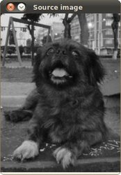
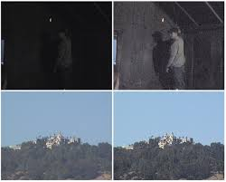
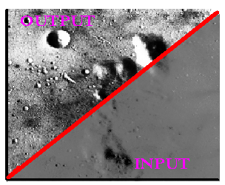
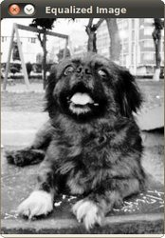
Applying intensity normalisation and histogram equalisation
http://homepages.inf.ed.ac.uk/rbf/HIPR2/histeq.htm; http://docs.opencv.org/doc/tutorials/imgproc/histograms/histogram_equalization/histogram_equalization.html ; http://www.softpedia.com/get/Multimedia/Video/Other-VIDEO-Tools/Easy-Histogram-Equalization.shtml

Slide 14

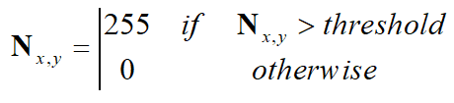
Thresholding an eye image
Thresholding selects points that exceed a chosen threshold

Slide 15
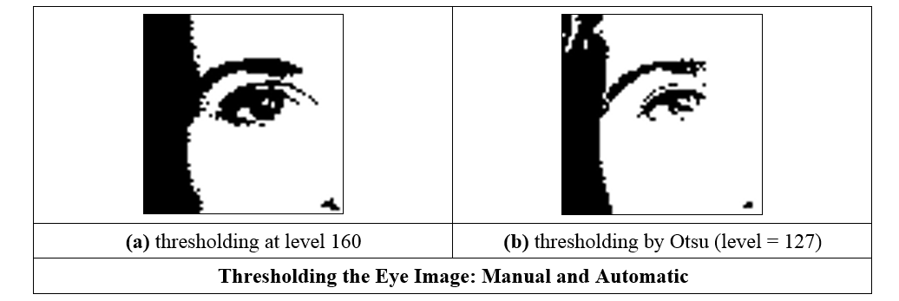
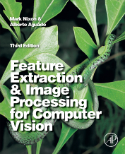
Thresholding an eye image: manual vs automatic
Is optimal thresholding a myth??

Slide 16
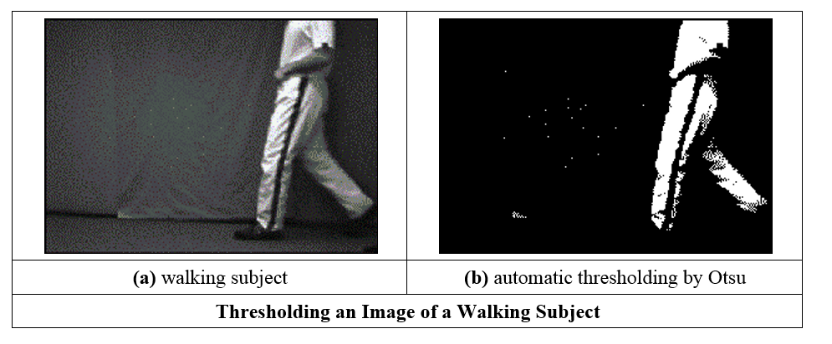
Thresholding an image of a walking subject
Many consider that shape concerns a higher level

Slide 17
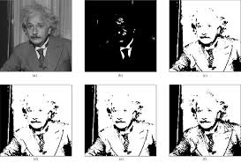
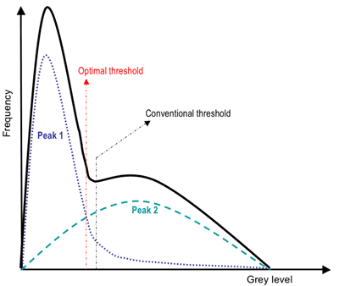
Advanced thresholding
Entropic thresholding (2010)
Optimal thresholding
http://opticalengineering.spiedigitallibrary.org/article.aspx?articleid=1096546; https://www.cs.auckland.ac.nz/courses/compsci773s1c/lectures/ImageProcessing-html/topic3.htm

Slide 18

Takeaway time
point operators are largely about image display
concern histogram manipulation
thresholding used a lot
intensity normalisation used for display
Need sets of points. That’s group operators, coming next.
Notes:
Bitter virtue

